Slide 1
Subject Name :Operating System Presentation Title: IBM System/360
JEPPIAAR INSTITUTE OF TECHNOLOGY
“Self-Belief | Self Discipline | Self Respect”
Department of Computer Science and Engineering
Team Members:
Students Name Reg.No:
1.Deshmukh.P 210618104011
2.Aravindar.G.D 210618104004
3.Mohamad Ameer.A 210618104029
4.Ajith.S 210618104003
5.Pradeep
6.Sanjeev

Slide 2
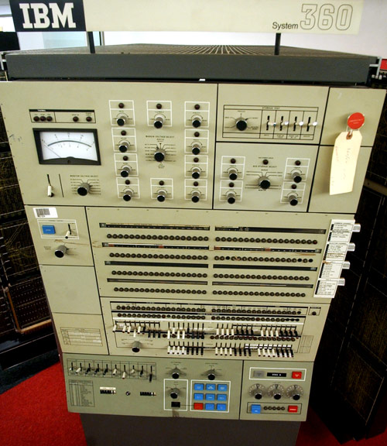
Objective
To study about the world’s first Operating system.
Cost of the Operating System
Architecture of the World’s first Operating System

Slide 3
Technical Details
Batch Processing
Hard disk permanent storage device (selectron tube, punch cards, punched tape, Magnetic drum memory)
Size

Slide 4
Features
16 32-bit general-purpose registers
4 64-bit floating point registers
64-bit processor status register
24-bit (16 MB) byte-addressable memory space

Slide 5
Memory
8 bit bytes
Halfword(2 bytes), Fullword(4 bytes), doubleword(8 bytes),quad word(16 bytes)
16,777,216 bytes of memory
Model 67 = 4,294,967,296

Slide 6
Instruction Formats
RR (two bytes) 1 byte-------> two 4-bit registers
RS (four bytes) 1 byte-----> two register numbers
RX (four bytes)
- 0 to 3 bits ------> register number or modifier
- 4 to 7 bits ------> index of register number
SI (four bytes) 1 byte-----> immediate field
SS (six bytes) 1 byte-----> two 4-bit length fields or one 8-bit length field

Slide 7
Operator Controls
System Reset
Initial Program Load
Emergency pull switch
Power on
Power Off
Interrupt key
Manual light(CPU Stopped)
Stop Key
Start Key

Slide 8
Other Features
Byte-aligned Operands
Decimal arithmetic
Floating-point arithmetic( 4 64-bit floating registers)
Multi-system operation
Storage protection (prevent a defective application from writing)

Slide 9
Facts
Changed everything
First computer able to upgrade
$5 billion to develop
Backstory
“Jewel" of the office

Slide 10
Result & Discussion
High cost
High technical staff
Hardware crash
Mad men(Thomas J.Watson, Vin Learson)

Slide 11
Future Scope
VS series
XE series
XYS series
XYN series
XC6 series
A01 series
ZOS series
I series

Slide 12
Reference
IBM (June 1968), IBM System/360 Model 85 Functional Characteristics (PDF), SECOND EDITION, A22-6916-1.
IBM (September 1968), IBM System/360 Principles of Operation (PDF), Eighth Edition, A22-6821-7. Revised by IBM (May 12, 1970), ibid., GN22-0354. and IBM (June 8, 1970), ibid., GN22-0361.
https://www.nbcnews.com/tech/gadgets/5-reasons-love-mad-mens-new-star-ibm-360-n101716
IBM (1968-03-18), IBM System/360 Model 91 Functional Characteristics (PDF), Third Edition, A22-6907-2.
https://en.wikipedia.org/wiki/IBM_System/360_architecture#Operator_controls

